Slide 1
FINAL YEAR PROJECT
CRYPTOLOCKER
BATCH D 3
PRESENTED BY
PARTHEEBAN D RAHU RAMAN N RAM PRASAD S
2017PECCS321 2017 PECCS 334 2017PECCS344
211417104179 211417104210 211417104218
GUIDE NAME
M SHANMUGANATHAN, M.Tech

Slide 2

I N T R O D U C T I O N
PURPOSE
Crptolocker is the safest way to keep track of text and non-media datas. One can easily keep track of his/her password of different accounts on the go. The two-factor authentication in the Crptolocker app adds even more security.
SCOPE
As people have started using different application the creation of confidential texts have been increased in recent times. This has created a cumbersome in saving those text data and remembering those passwords which have paved a way for variety of secure application to store their passwords.

Slide 3
LITERATURE SURVEY
YEAR | AUTHOR | COUNTRY | OBJECTIVE | CONTRIBUTION | DATA | METHODOLOGY | CONCLUSION
2012 International Workshop on Information and Electronics Engineering (IWIEE) | Kun Liua , Long-jiang Dong | Beijing Union University, Beijing China | The concept of cloud computing becomes more and more popular in latest years. Data storage is a very important and valuable research field in cloud computing. This paper introduces the concept of cloud computing and cloud storage as well as the architecture of cloud storage firstly. | This research paper helped in clearing the doubts about cloud computing and the way in which the data’s are stored. | Cloud storage is a system that provides functions such as data storage and business access | Hadoop is hosted by the Apache Software Foundation | Cloud computing is the inevitable product with the development of the internet, and it also brings more rich applications to the internet.

Slide 4
PROBLEM STATEMENT
Even though Security, Privacy and Trust issues exists since the evolution of Internet, the reason why they are widely spoken these days is because of the Cloud Computing scenario. Any client/small organization/enterprise that processes data in the cloud is subjected to an inherent level of risk because outsourced services bypass the "physical, logical and personnel controls" of the user . When storing data on cloud, one might want to make sure if the data is correctly stored and can be retrieved later. As the amount of data stored by the cloud for a client can be enormous, it is impractical (and might also be very costly) to retrieve all the data, if one’s purpose is just to make sure that it is stored correctly. Hence there is a need to provide such guarantees to a client. Hence, it is very important for both the cloud provider and the user to have mutual trust such that the cloud provider can be assured that the user is not some malicious hacker and the user can be assured of data consistency, data storage and the instance he/she is running is not malicious. Hence the necessity for developing trust models/protocols is demanding.

Slide 5

A B S T R A C T
Many systems rely on passwords for authentication. Due to numerous accounts for different services, users have to choose and remember a significant number of text datas. Crptolocker applications address this issue by storing user’s confidential texts. They are especially useful on mobile devices, because of the ubiquitous instant access. Crptolocker often use key derivations functions to convert a master password into cryptographic key suitable for encrypting the stream of texts, thus protecting the password against unauthorized, off-line access. Therefore, design and implementation problems in the key derivation function can render the encryption on the files is useless, by for example allowing efficient brute force attacks, or even worse- direct decryption of the stored files.

Slide 6

S Y S T E M A N A LY S I S
EXISTING SYSTEM
The existing system has around 100K downloads many people have found useful. The existing system similar
but with some outdated features .
DISADVANTAGE OF EXISTING SYSTEM
The existing application does not provide cloud storage facility. As the result if he/she lost his device, the passwords is lost along with the device since every text data are stored in local. It has major UI glitches.

Slide 7
ADVANTAGES OF PROPOSED SYSTEM
Builds discipline and organization
Gives you instant access to your confidential texts.
Highly secured using advanced security algorithms.
Know your storage
Auto-fill features
APPLICATION OF PROPOSED
SYSTEM
This application will help the user who travel and need access to their passwords. The highly secured cloud storage ensures instant access to their text data any where from the world. It makes the user comfortable in remembering their passwords and storing important files without the knowing of other user’s.

Slide 8
TOO L S & L A NG UA G E S US E D
IDE
HARDWARE
REQUIREMENTS
SOFTWARE REQUIREMENS
Android Studio
i3 Processor Based Computer
1GB-Ram
5 GB Hard Disk
Internet Connection
Android Device
Windows 7 or higher
Android Development Toolkit(ADT)
Visual Studio 2010
Firebase
Android 4.0 or higher
UI DESIGN
Adobe XD
LANGUAGE
1 GB RAM
4 GB ROM
Processor 1.2 Ghz Dual Core or Higher
JAVA
XML

Slide 9

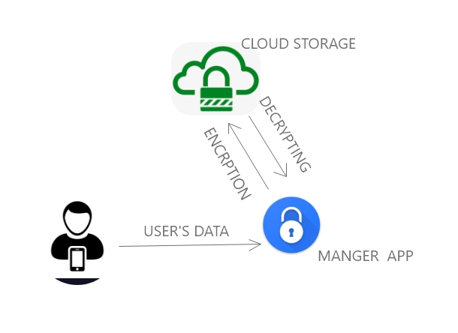
MODEL

Slide 10
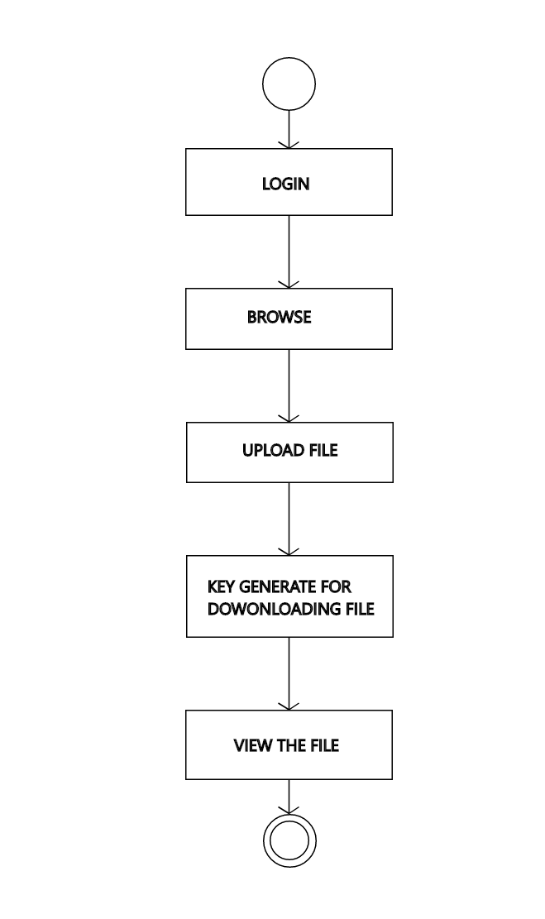
ACTIVITY DIAGRAM

Slide 11
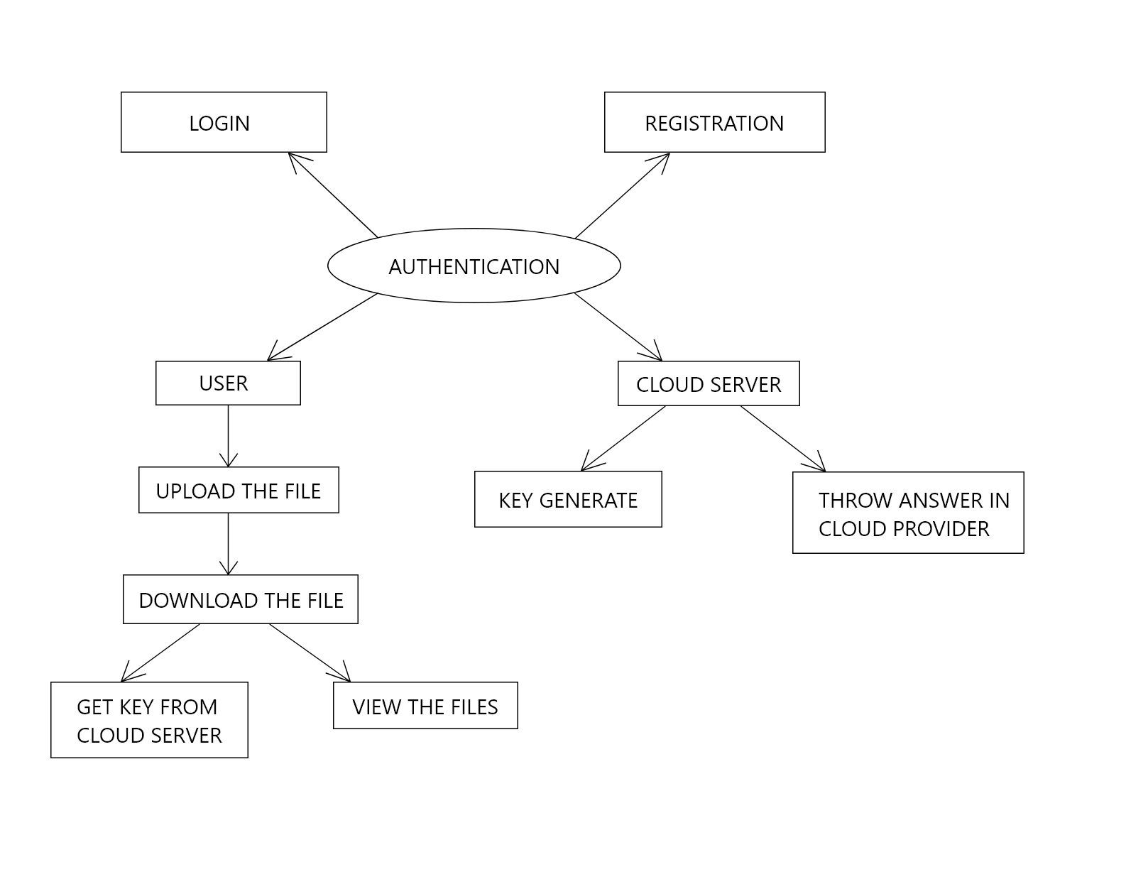
ER DIAGRAM

Slide 12
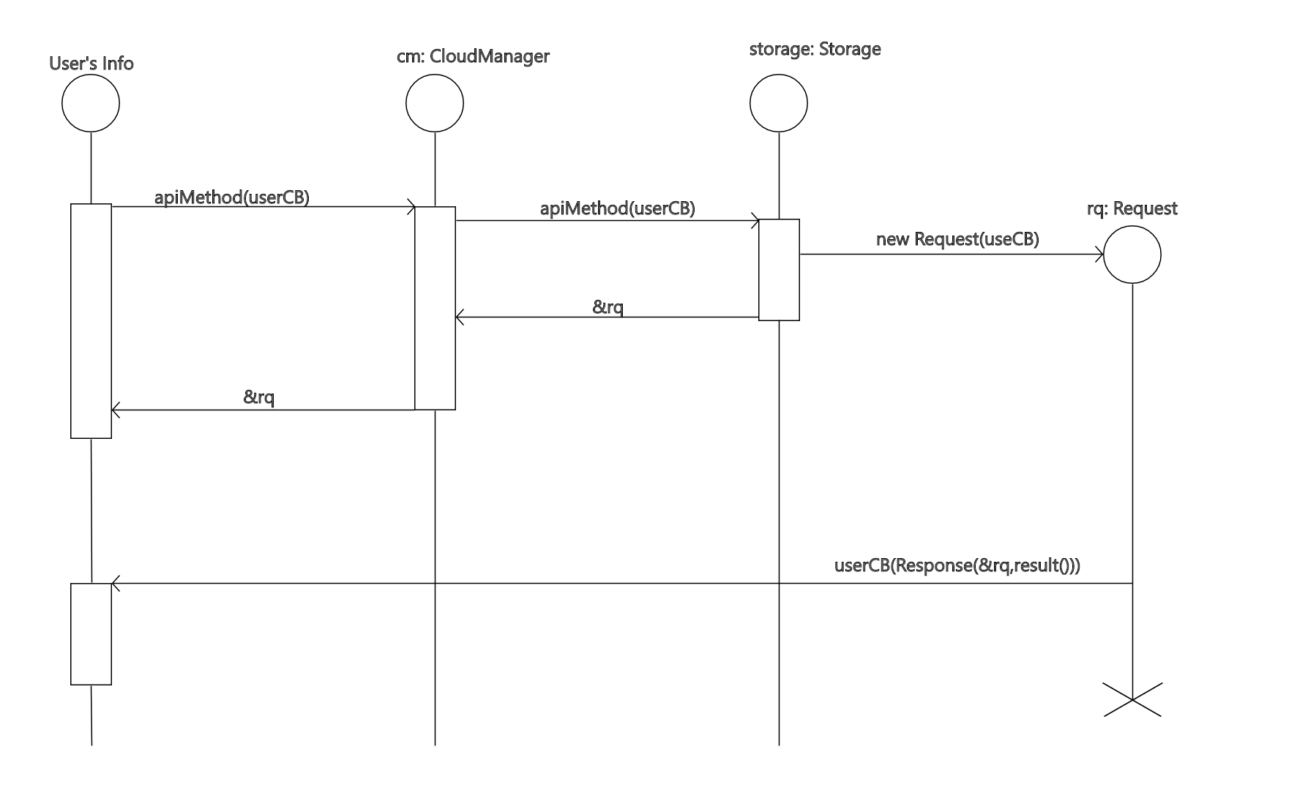
SEQUENCE DIAGRAM

Slide 13
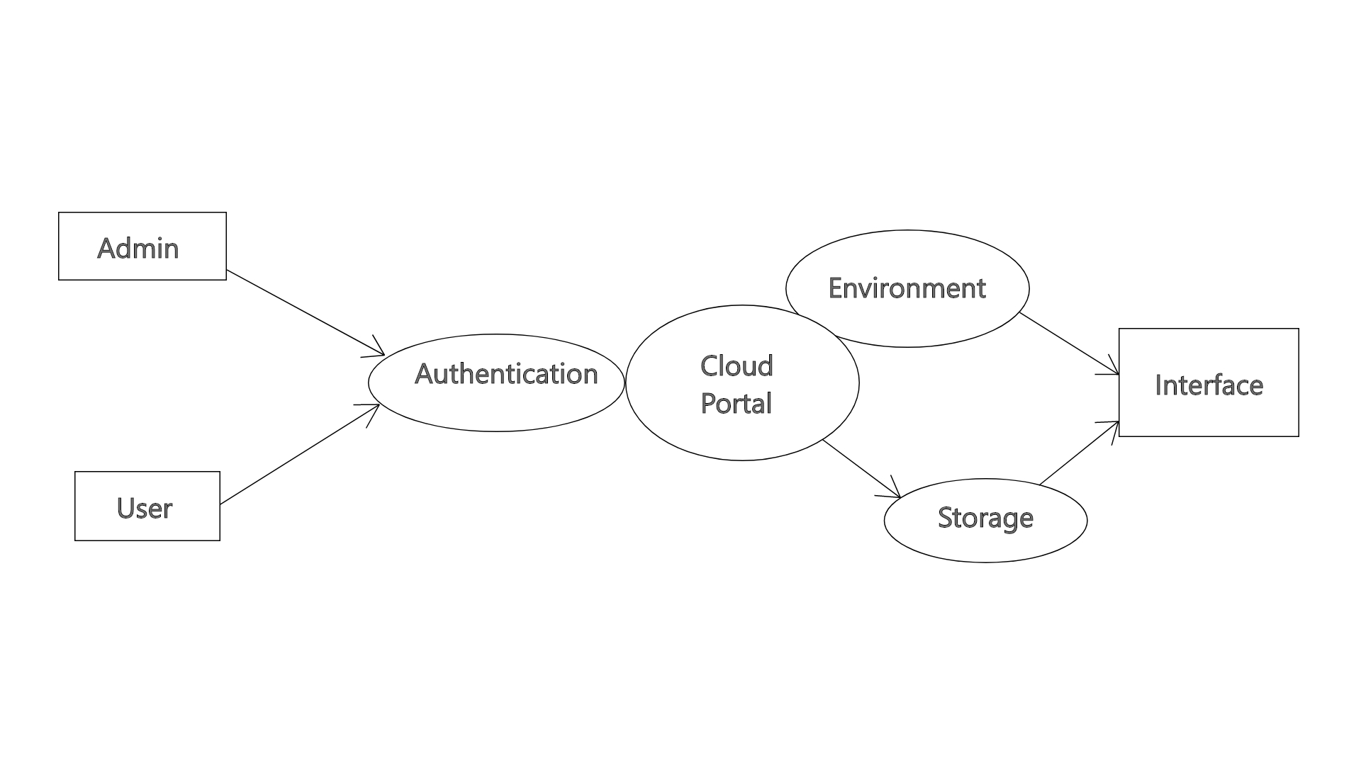
DFD DIAGRAM

Slide 14
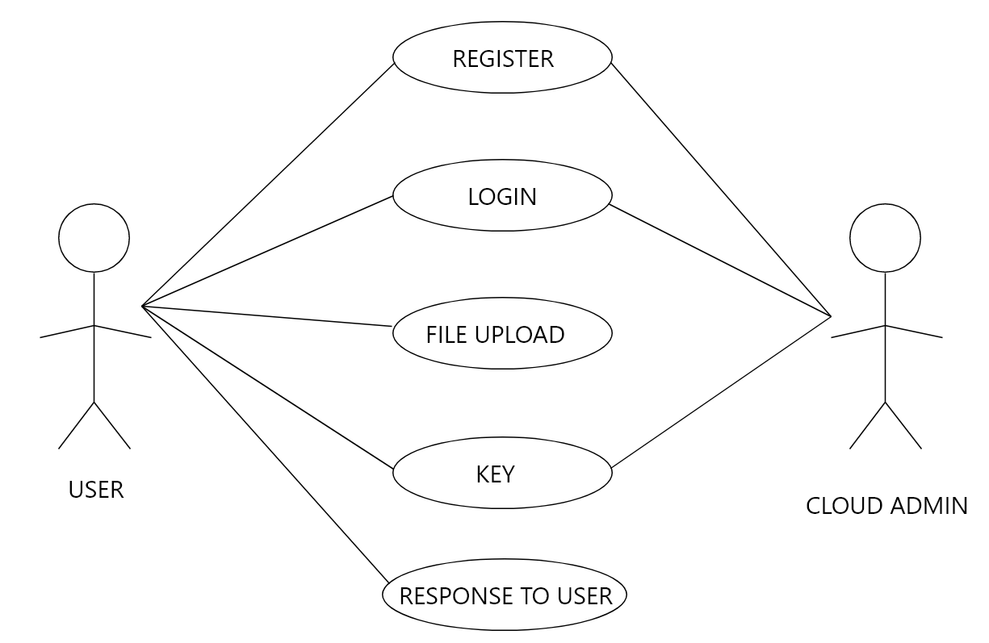
USE CASE DIAGRAM

Slide 15
DATABASE TABLES
USER REGISTRATION
COLUMN NAME | DATA TYPE
E-MAIL ID | VARCHAR(100)
USER NAME | VARCHAR(100)
PASSWORD | VARCHAR(100)
CONFIRM PASSWORD | VARCHAR(100)
ADDRESS | VARCHAR(100)
ZIP CODE | VARCHAR(100)
MOBILE NO | VARCHAR(100)

Slide 16
USER LOGIN
COLUMN NAME | DATA TYPE
E-MAIL ID | VARCHAR(100)
USER NAME | VARCHAR(100)
PASSWORD | VARCHAR(100)
CONFIRM PASSWORD | VARCHAR(100)
ADDRESS | VARCHAR(100)

Slide 17
FILES
COLUMN NAME | DATA TYPE
ID | INT
USER NAME | VARCHAR(50)
NAME | VARCHAR(100)
CONTENT TYPE | VARCHAR(50)
SIZE | INT
DATA | VARBINARY(MAX)

Slide 18
FILES UPLOAD
COLUMN NAME | DATA TYPE
FILENAME | VARCHAR(100)
FILE PATH | VARCHAR(100)
RKEY | NUMERIC(18,0)
SIZE | INT

Slide 19
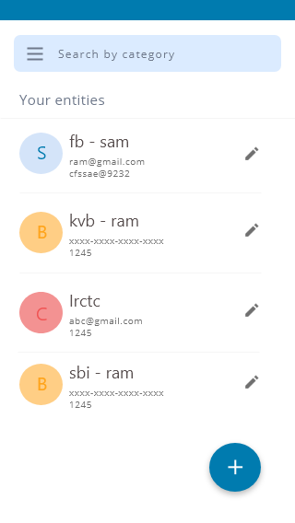
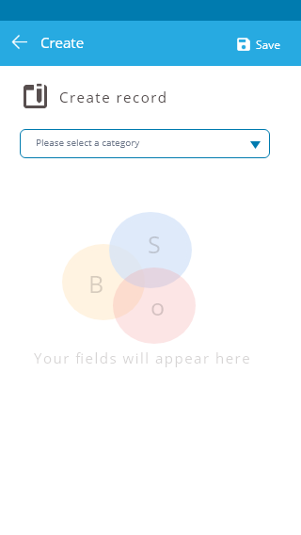
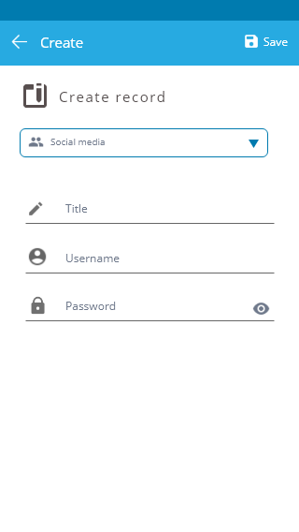
WORK DONE

Slide 20

CO N C LU S I O N
The proposed android application is simple, fast, secure and user friendly to manage user’s Personnel data and securely store them in cloud for instant access. Crptolocker is simple and easy to use app that helps in managing your passwords and files of different account. This will be a best app under 15MB to manage your files and password.

Slide 21
R E F E R E N C E
https://www.slideshare.net/ShashankSrivastava58/cloud-storage-and-security-52470839?from_action=save
https://www.youtube.com/watch?v=Z-RE1QuUWPg
https://www.youtube.com/watch?v=fis26HvvDII

